Slide 1
School Database System A SQL-Based Data Management Solution
SHAIKH FAYAZ

Slide 2
INTRODUCTION
This project focuses on developing a School Student Records Management System using SQL. The system efficiently manages student data, including personal details, course enrollments, grades, and attendance. By utilizing a relational database, the project ensures data accuracy, security, and easy access, simplifying the administrative processes within an educational institution.

Slide 3
Objectives
Create a structured database for student records.
Automate enrollment, attendance, and grade management.
Ensure data accuracy, integrity, and security.
Provide easy data access for authorized users.

Slide 4
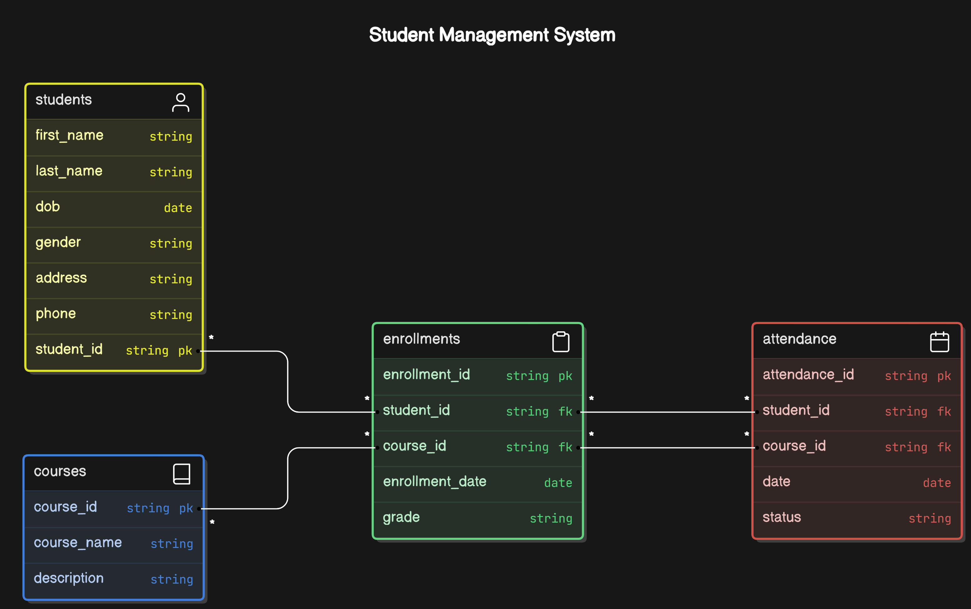
ER-DIAGRAM

Slide 5
STRUCTURE OF TABLE

Slide 6
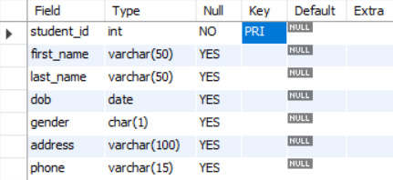
STUDENTS TABLE
Purpose: The Students table holds fundamental information about each student enrolled in the school. This table is crucial for identifying and managing students.
CREATE TABLE Students (
student_id INT PRIMARY KEY,
first_name VARCHAR(50),
last_name VARCHAR(50),
dob DATE, gender CHAR(1),
address VARCHAR(100),
phone VARCHAR(15));

Slide 7

COURSES TABLE
Purpose: The Courses table maintains details about the courses offered by the school, including their names and descriptions.
CREATE TABLE Courses (
course_id INT PRIMARY KEY,
course_name VARCHAR(100),
description TEXT);

Slide 8
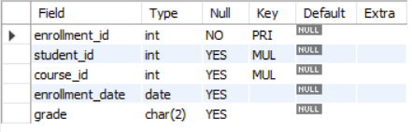
ENROLLMENTS TABLE
Purpose: The Enrollments table tracks which students are enrolled in which courses, along with enrollment dates and grades.
CREATE TABLE Enrollments (
enrollment_id INT PRIMARY KEY,
student_id INT,
course_id INT,
enrollment_date DATE,
grade CHAR(2),
FOREIGN KEY (student_id) REFERENCES Students(student_id),
FOREIGN KEY (course_id) REFERENCES Courses(course_id));

Slide 9
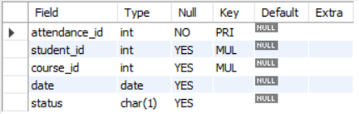
ATTENDANCE TABLE
Purpose: The Attendance table records attendance details for each student in their respective courses, tracking their presence or absence.
CREATE TABLE Attendance (
attendance_id INT PRIMARY KEY,
student_id INT,
course_id INT,
date DATE,
status CHAR(1),
FOREIGN KEY (student_id) REFERENCES Students(student_id),
FOREIGN KEY (course_id) REFERENCES Courses(course_id));

Slide 10
CONTENTS OF TABLE

Slide 11
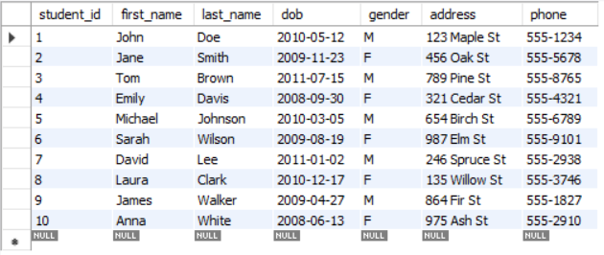
STUDENTS

Slide 12
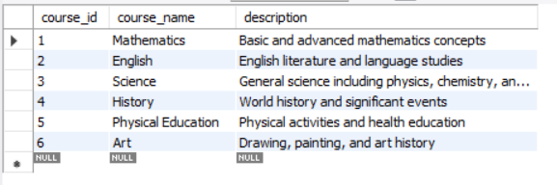
COURSES

Slide 13
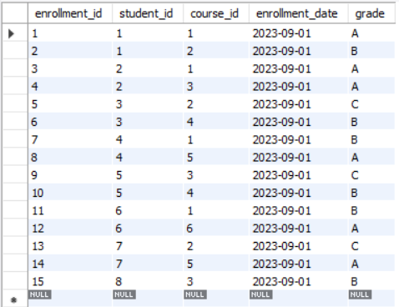
ENROLLMENTS

Slide 14
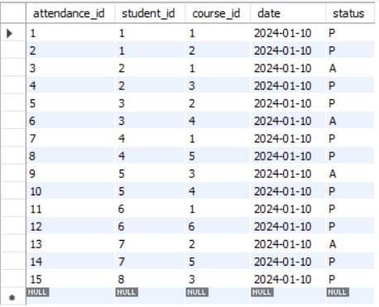
ATTENDANCE

Slide 15
QUERIES ALONG WITH Q/A

Slide 16
What are the details of all students?
SELECT * FROM Students;

Slide 17

Which courses is student with ID 2 enrolled in?
SELECT e.enrollment_id, c.course_name, e.enrollment_date, e.grade
FROM Enrollments e
JOIN Courses c ON e.course_id = c.course_id
WHERE e.student_id = 2;

Slide 18

What is the attendance status for student ID 1 in course ID 1 on 2024-01-10?
SELECT a.date, a.status
FROM Attendance a
WHERE a.student_id = 1 AND a.course_id = 1 AND a.date = '2024-01-10';

Slide 19

What is the average grade for course ID 1?
SELECT AVG (CASE
WHEN grade = 'A' THEN 4.0
WHEN grade = 'B' THEN 3.0
WHEN grade = 'C' THEN 2.0
WHEN grade = 'D' THEN 1.0
ELSE 0.0
END )
AS average_grade
FROM Enrollments
WHERE course_id = 1;

Slide 20
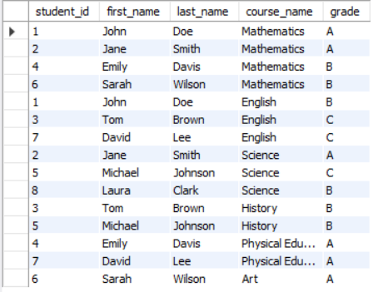
What are the courses and grades for each student?
SELEC s.student_id, s.first_name, s.last_name, c.course_name, e.grade
FROM Students s
JOIN Enrollments e ON s.student_id = e.student_id
JOIN Courses c ON e.course_id = c.course_id;

Slide 21
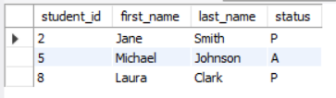
What is the attendance status for course ID 3 on 2024-01-10?
SELECT s.student_id, s.first_name, s.last_name, a.status
FROM Attendance a
JOIN Students s ON a.student_id = s.student_id
WHERE a.course_id = 3 AND a.date = '2024-01-10';

Slide 22
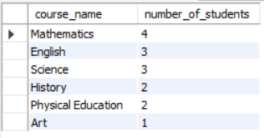
How many students are enrolled in each course?
SELECT c.course_name, COUNT(e.student_id) AS number_of_students
FROM Enrollments e
JOIN Courses c ON e.course_id = c.course_id
GROUP BY c.course_name;

Slide 23
THANK YOU

